Slide 1
CORONA VIRUS INSIGHTS
Using SQL

Slide 2
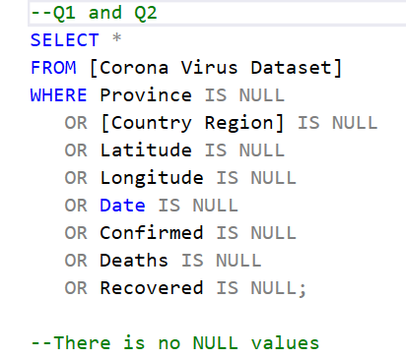
Data cleaning
- Retrieving rows with null values that exist in each column using SELECT, FROM, WHERE statements.
- I didn’t find any null values.

Slide 3
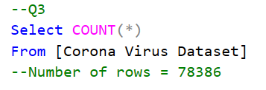
Data exploration
- Checking the total number of rows using SELECT, FROM statement to start getting insights

Slide 4
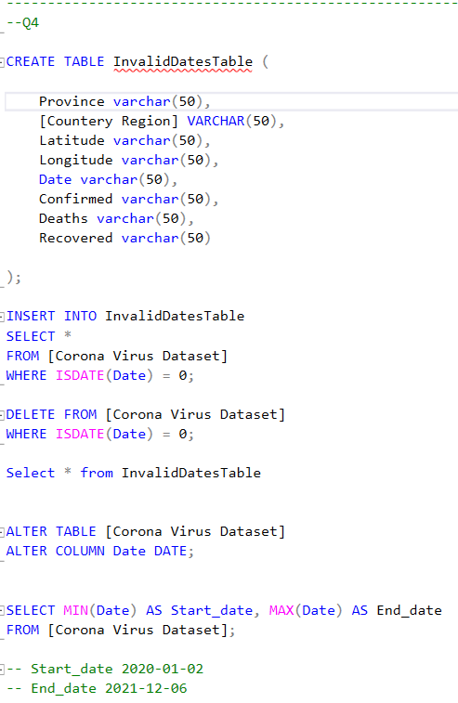
Data exploration
- In this part I was checking start and end date.
- But I found some rows that have issues happened in the data entry level and the problem was that I found these rows entered in data type STRING which can’t be converted into DATE data type.
-To solve this problem I got rid of these rows to enable me to get insights from the other rows and saved the invalid data type rows in another table to be available in case of we need them in any time,
- Then I defined the start date and end date in the valid data table using min and max to get the oldest and newest date exist.

Slide 5
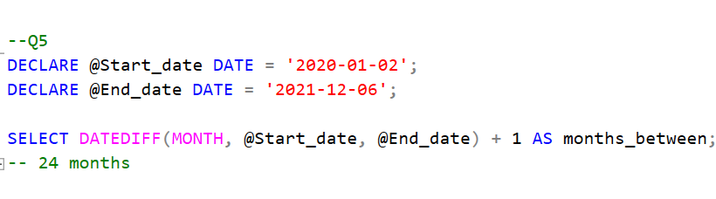
Data exploration
- Declaring variables and assigning the start date and end date.
- Using DATEDIF function to calculate the difference between the start date and end date in terms of months and naming the result column as months_between.

Slide 6
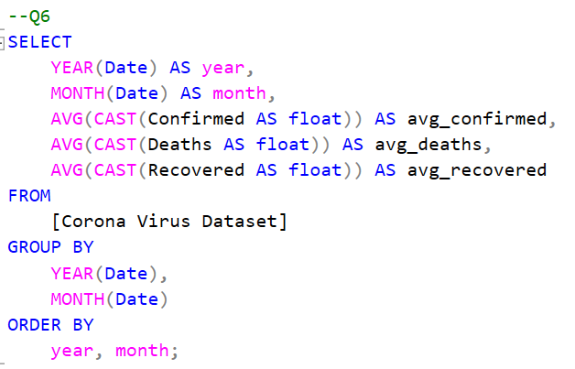
GETTING INSIGHTS
-Extracting the year and month components from the Date column.
- Change the data type of the columns to float to calculate the average value for Confirmed, Deaths, Recovered columns.
- Grouping and ordering the data by the year and month.

Slide 7
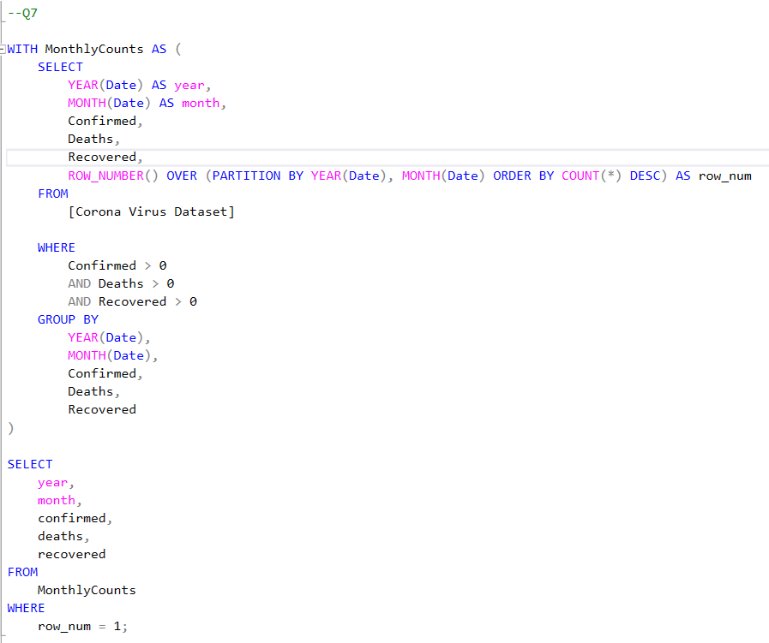
Getting insights
- Define a CTE with name “MonthlyCounts” using clause WITH to calculate the counts of confirmed cases, deaths and recoveries for each month grouped by year and month.
- Assigning a row number for each row within each group ordered by the count in descending order.
- Then selecting the year, month, confirmed cases, deaths and recoveries from “MonthlyCounts” Where the row number is one, indicating the month with the highest counts.

Slide 8
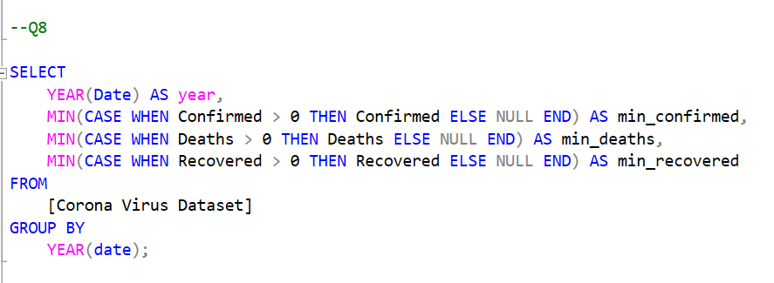
Getting insights
- Extracting the year component from Date column with name “year”.
- Getting the min values for confirmed, deaths and recovered with excluding zero values.
- Grouping data by the year.

Slide 9
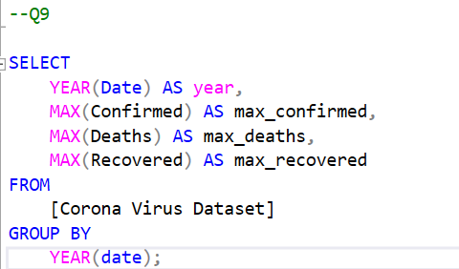
Getting insights
- Extracting the year component from Date column with name “year”.
- Getting the max values for confirmed, deaths and recovered.
- Grouping data by the year.

Slide 10
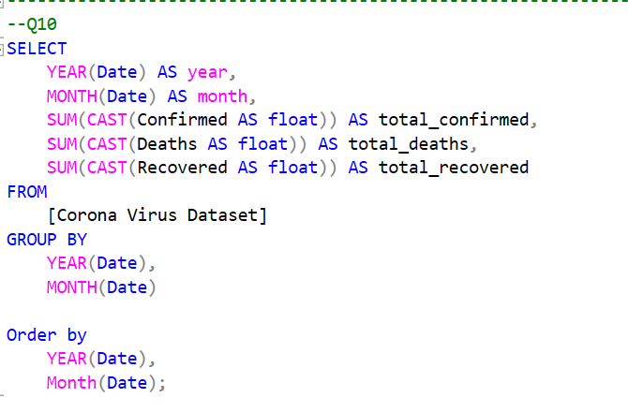
Getting insights
- Extracting the year and month components from Date column with name “year”.
- Getting the total values for confirmed, deaths and recovered for each month.
- Grouping and ordering data by the year and month.

Slide 11
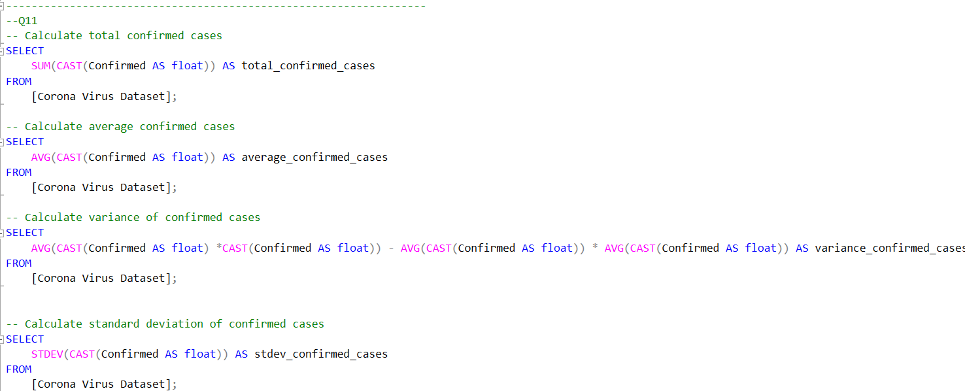
Getting insights
- Retrieving and change the data type of confirmed cases to float.
- Then calculating sum, average, variance, and std to for confirmed cases to discover the spreading out of corona virus with respect to confirmed cases .

Slide 12
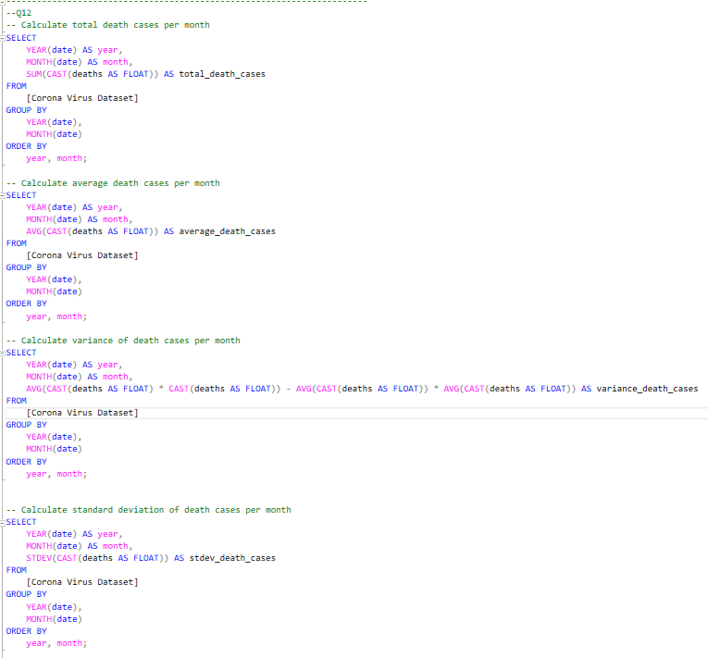
Getting insights
- Extracting the year and month components from Date column with name “year”.
- Retrieving and change the data type of deaths to float.
- Then calculating sum, average, variance, and std to for deaths to discover the spreading out of corona virus with respect to deaths per months.
- Grouping and ordering data by the year and month.

Slide 13
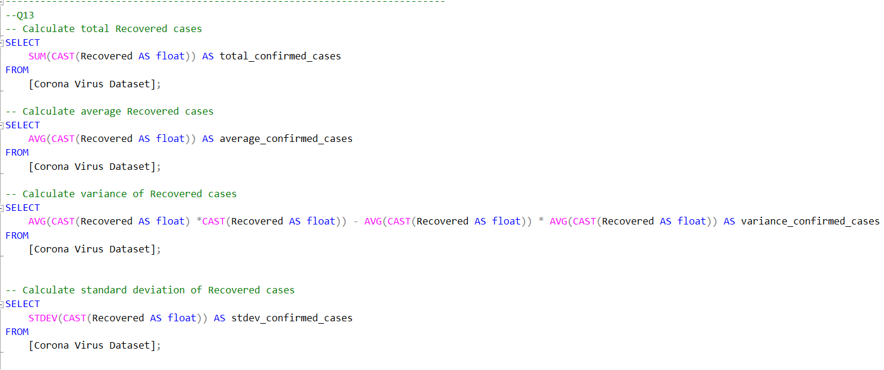
Getting insights
- Retrieving and change the data type of recovered cases to float.
- Then calculating sum, average, variance, and std to for deaths to discover the spreading out of corona virus with respect to recovered cases.

Slide 14
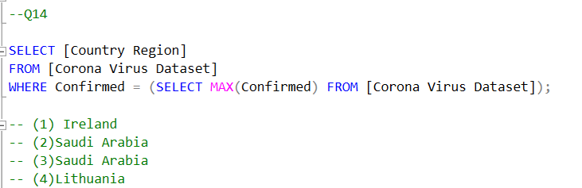
getting insights
- Retrieving the countries from “Country Region” column which have the max values of confirmed cases

Slide 15
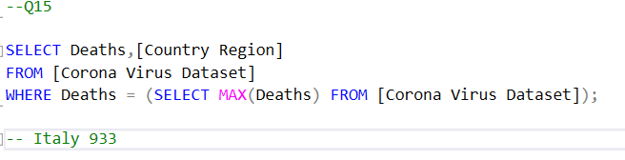
getting insights
- Retrieving the countries from “Country Region” column which have the min values of deaths and retrieving the number of deaths.

Slide 16
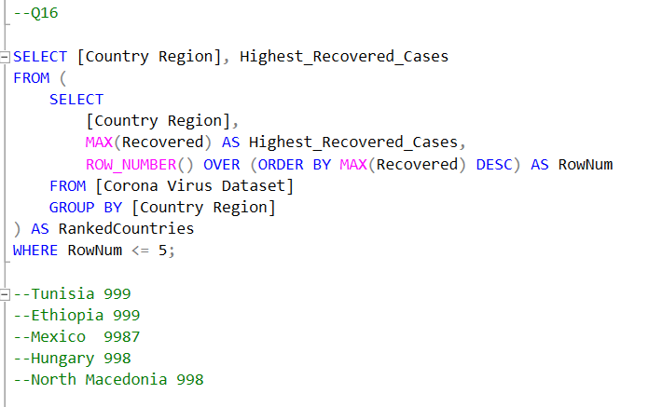
Getting insights
- Selecting the country and the highest recovery cases and rank results by giving is a row number.
- Ordering the ranked result descending and group it by the country.
- Retrieving the first five rows to get the highest five countries that have recovered cases.

